Slide 1
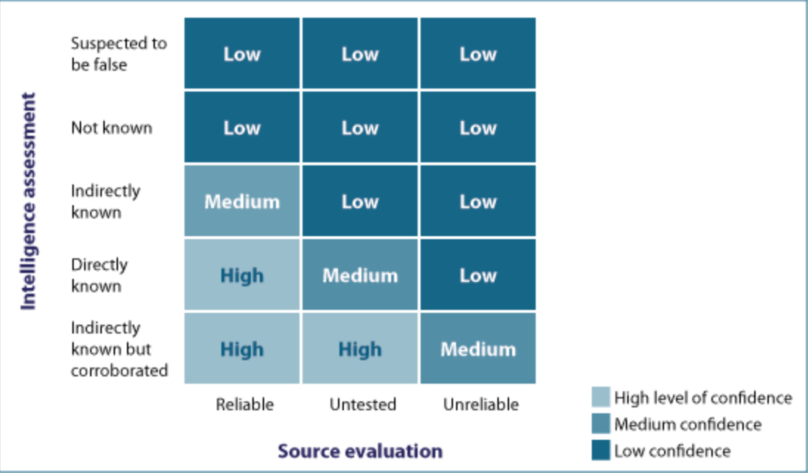
Confidence Matrix
Notes:
Any information that comes to light can be evaluated to assess it’s worth.
This is very useful when it is then passed on, as the next person/organisation can see the value of the information
The evaluation system you can see here is part of what is called the 3x5x2 evaluation process. Sounds complicated but the 3x5 bit relates to the three headings at the bottom and the 5 headings at the side of this graph.
Using this method helps those receiving the information to understand literally how much confidence they can have in it’s worth.
The information itself should be in the basic format of; what, when, where, who and why.-should be clear and without abbreviations. Remember when passing on to the LIN, each organisation will use abbreviations internally that need to be clarified and explained outside of each respective organisations.
Lets look at the bottom three headings;
Reliable
This grading is used when the source is believed to be both competent and information received is generally reliable.
e.g. DNA, fingerprints, CCTV
Untested
This relates to a source that has not previously provided information to the person receiving it or has provided information that has not been substantiated
This source may not be necessarily unreliable but the information should be treated with caution.
E.g. info from member of public, crimestoppers
Not reliable
This should be used when there are reasonable grounds to doubt the reliability of the source.
These grounds should be recorded, e.g. trustworthiness, competence or motives of the source.
e.g. members of the public with a potentially malicious motive
Now lets look at the headings on the left;
Suspected to be false;
Any such information must be treated with extreme caution
e.g. malicious staff member
Not Known;
Applies where there is no means of assessing the information.
This includes anonymous information
Indirectly known;
This applies to information that the source has been told by someone else. So, the source does not have first-hand knowledge of the information as they did not witness it themselves.
Directly known;
Refers to information obtained first-hand, e.g. through the source witnessing the event
Indirectly known but corroborated
Refers to information that the source has not witnessed themselves, but the reliability of the information can be verified by separate reliable information

